Slide 1


KADI SARVA VISHWAVIDYALAYA LDRP INSTITUTE OF TECHNOLOGY AND RESEARCH GANDHINAGAR
DEPARTMENT OF COMPUTER ENGINEERING
Hiring Buddy
Guided By,
Prof. Vishal Nayak
Created By,
Mayank Joshi (19BECE30109)
Lav Hadvani (19BECE30102)
Ankita Karavadra (19BECE30014)
Bhavisha Odedra (19BECE30507)

Slide 2
OUTLINE
Abstract
Scope Of The Project
Diagrams
Technologies
Requirements
Snapshots
Conclusion

Slide 3
ABSTRACT
Hiring Buddy is a placement management system that helps in managing students data in the college with regard to placement.
It intends to help fast in fast access procedures in placement related activities and ensures to maintain the details of the students.
It has the facility of maintaining the details of the students, thereby reducing the manual work.
It will save time and energy which are spending in making Excel sheets and collecting data.
The placement officer can update the status of students whether those are getting a job or not.

Slide 4
SCOPE OF THE PROJECT
It will save time and energy which are spending in making records and collecting data.
It improves existing system.
If any modification is required that is to be also done easily.
It will provide a user friendly interface so that any user can easily navigate through the system, but he/she should be capable of providing valid credentials for successful login.
The requirements and various posts of the company has to be updated and the placement admin cell send the mail to the students who are under requirement.

Slide 5


TECHNOLOGIES USED
HTML
CSS
BOOTSTRAP
JAVASCRIPT
PHP

Slide 6
REQUIREMENTS
Hardware Requirements
Software Requirements
Processor : Any Processor above 500 MHz.
Ram : 2 GB
Hard Disk : 4 GB
Input Device : Standard Keyboard and Mouse
Operating System : Windows 7 or higher
Programming :Visual Studio

Slide 7
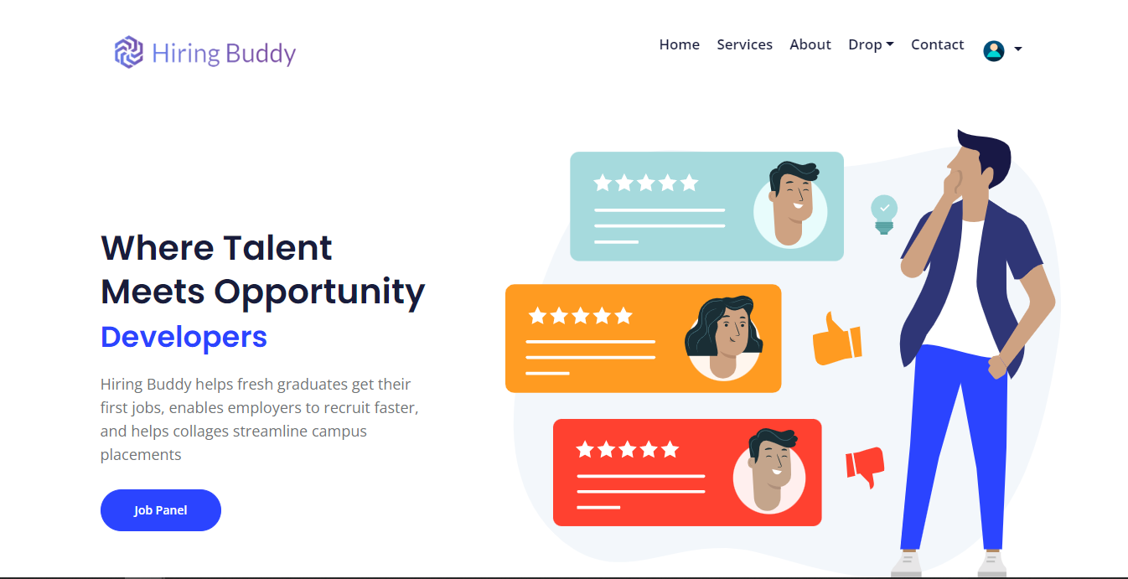
Landing Page

Slide 8
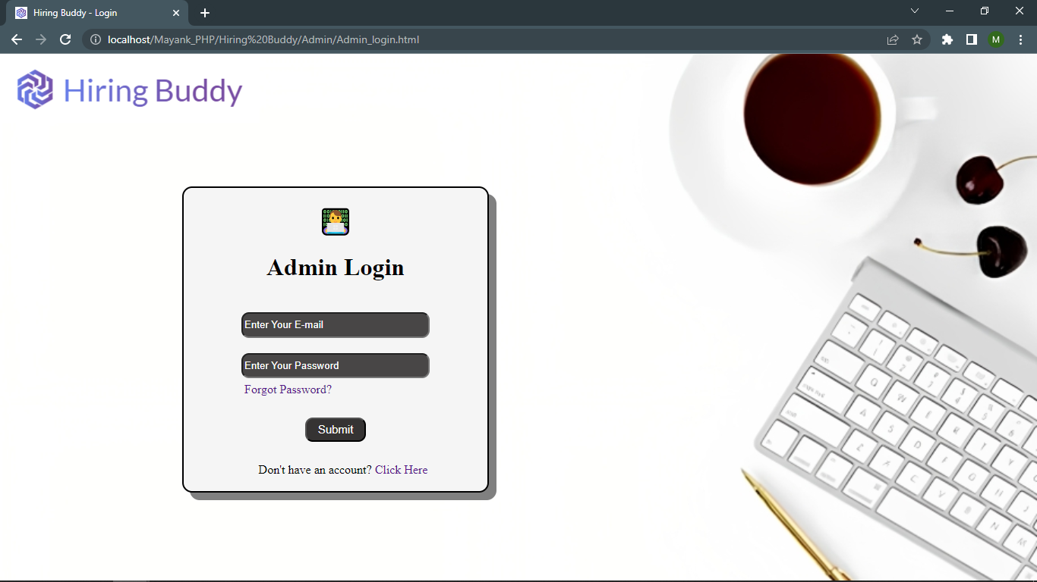
Admin Login Page

Slide 9
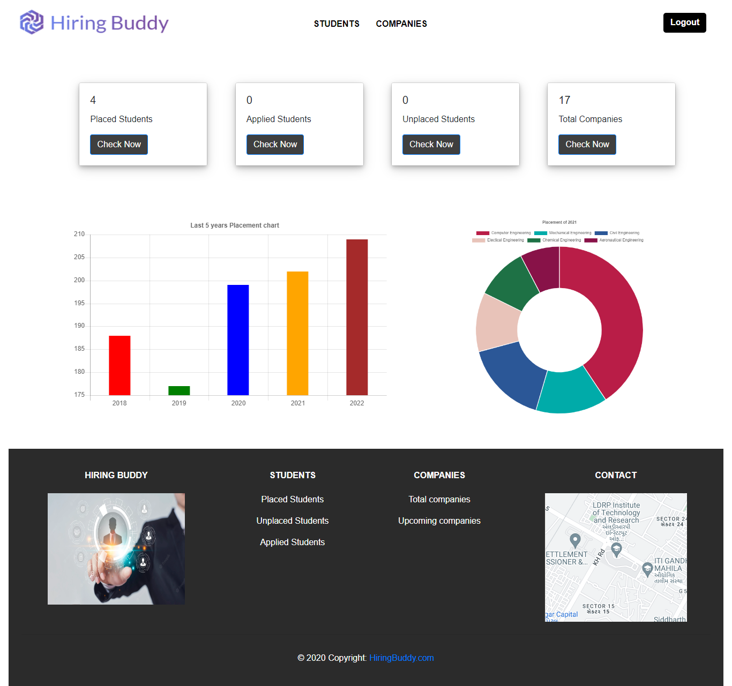
Admin Home Page

Slide 10
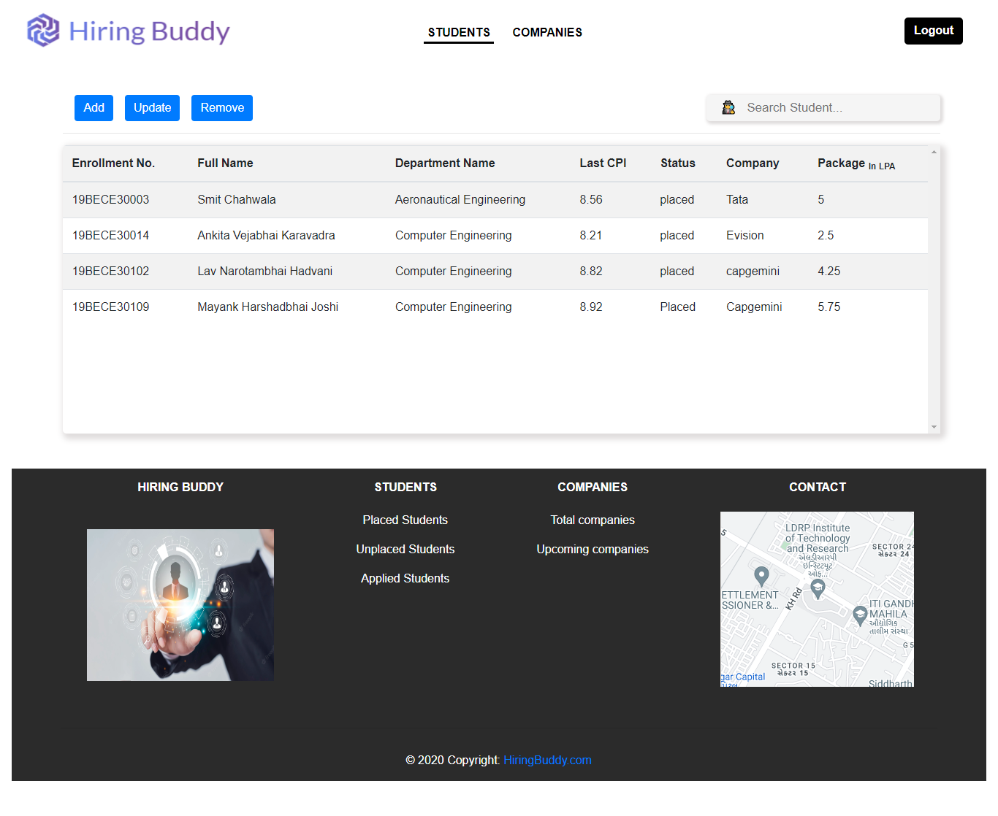

Slide 11
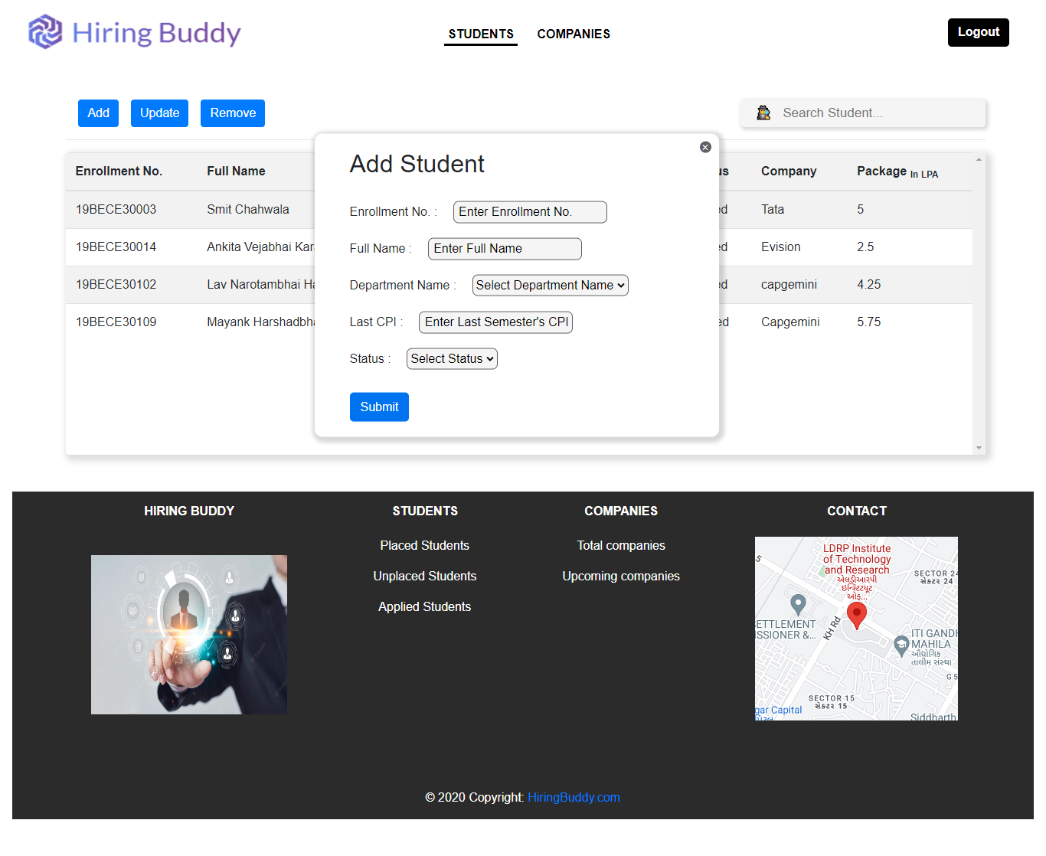

Slide 12
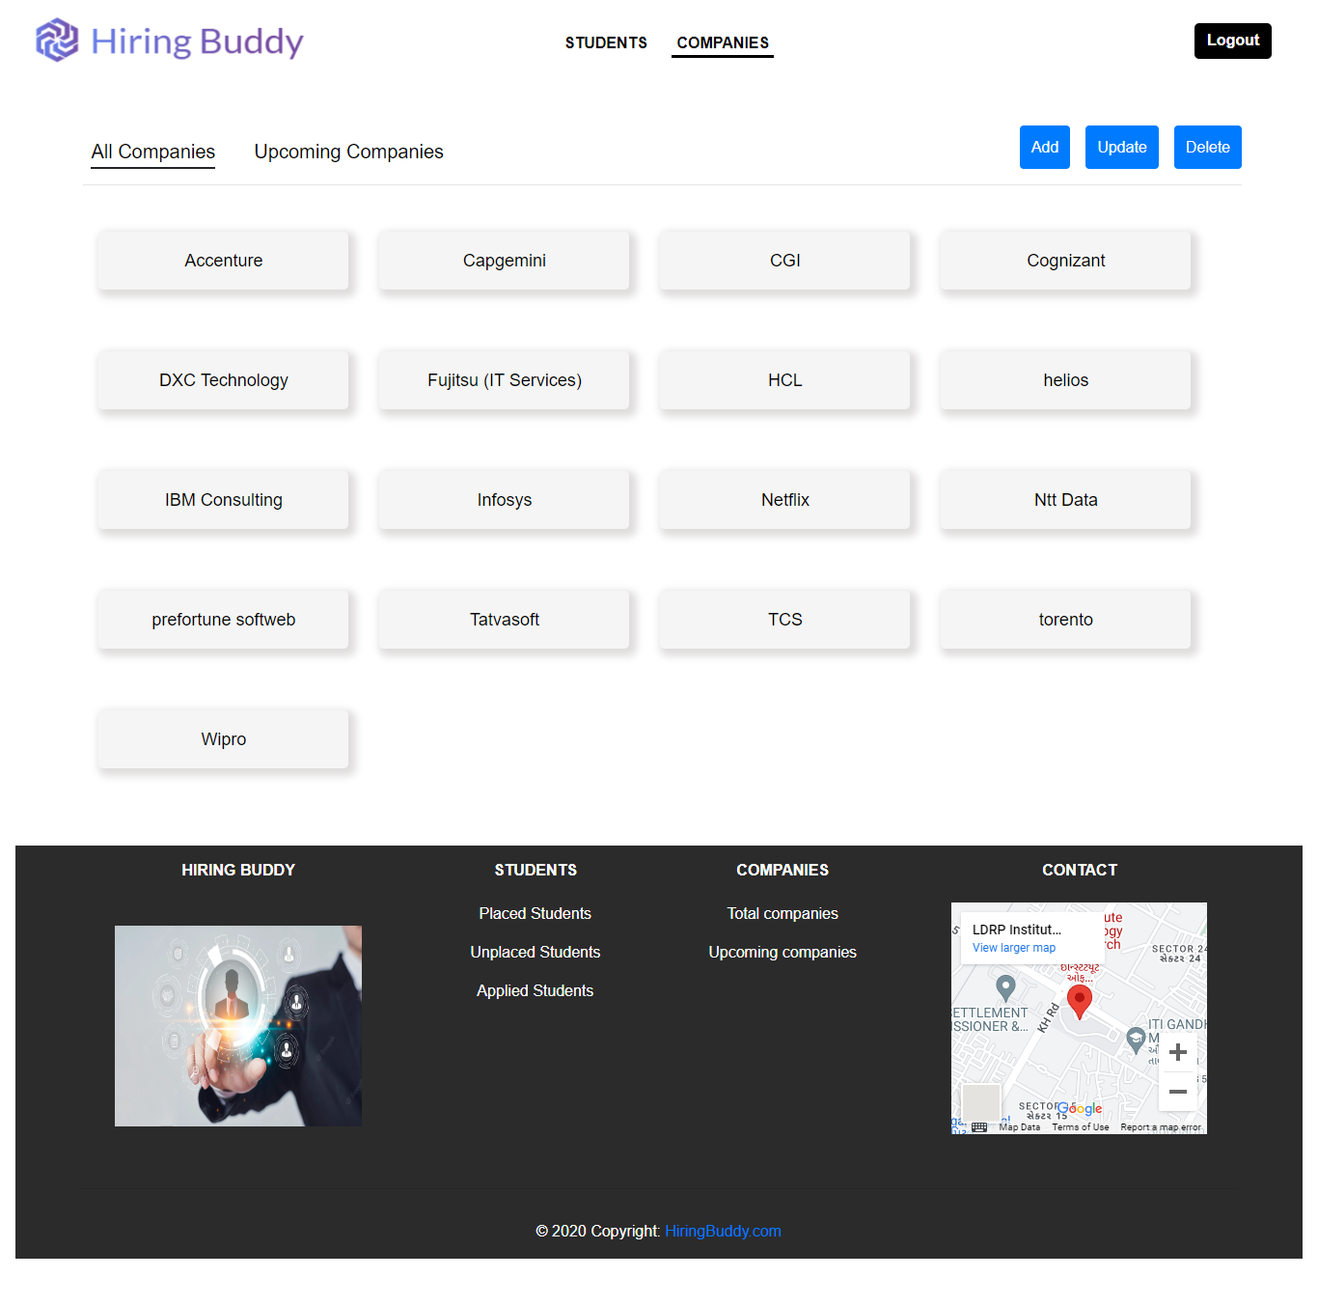
Company Home Page

Slide 13
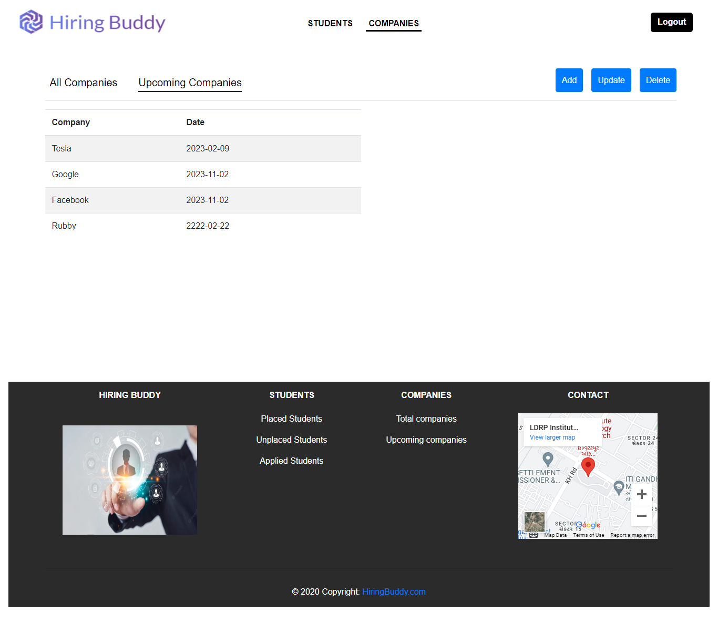
Upcoming Company Page

Slide 14
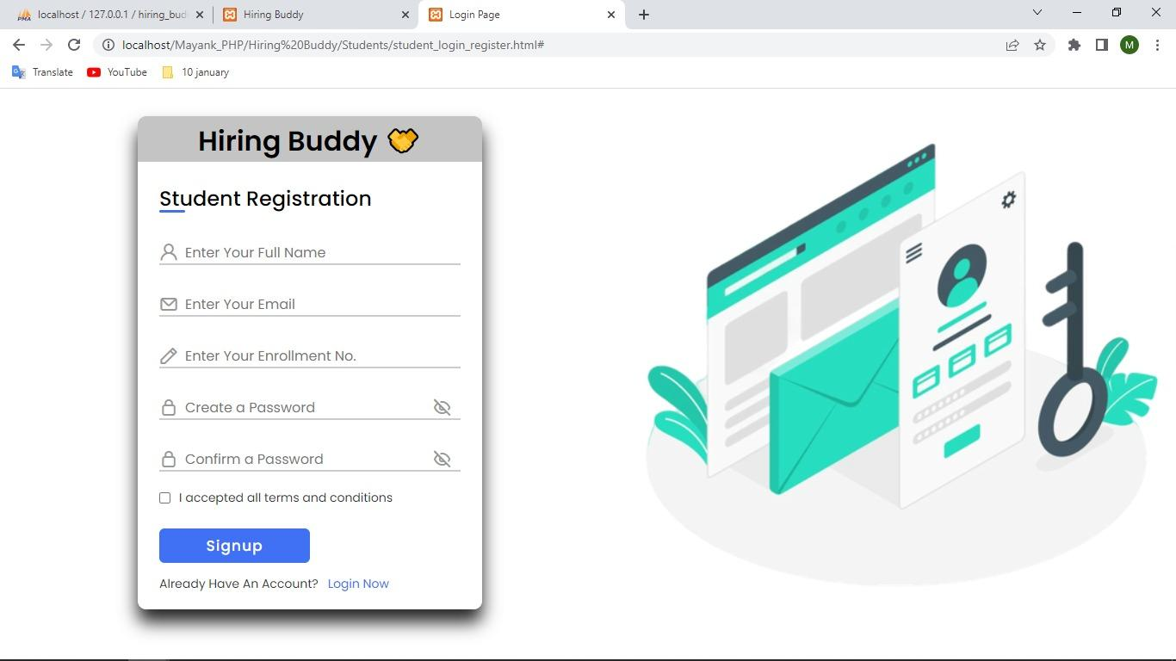
Student Registration Page

Slide 15
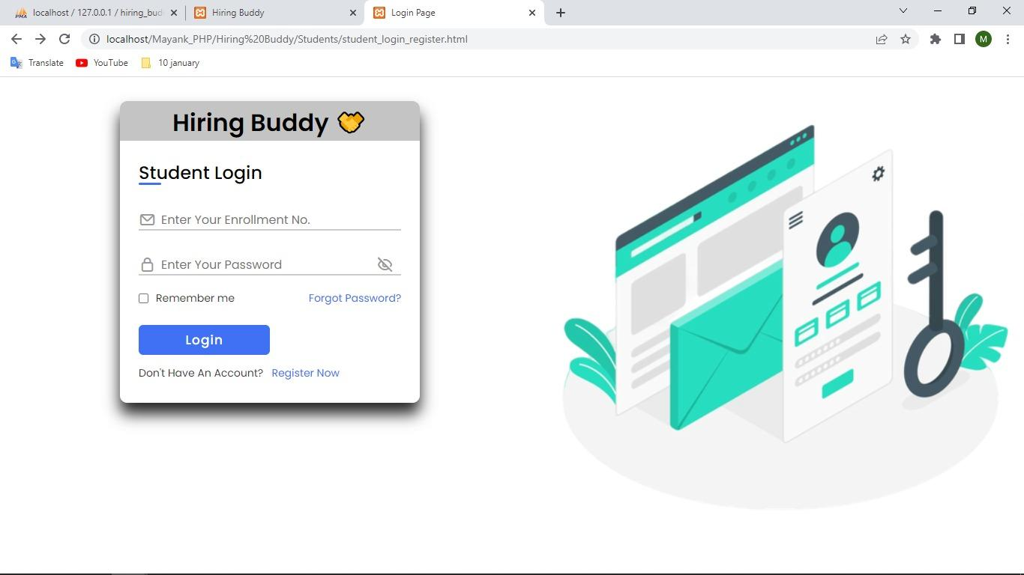
Student Login Page

Slide 16
CONCLUSION
Hiring Buddy manages student information in the college with regard to placement.
It also provide facility to companies which will held their campus drive in collages. In which they can communicate with college placement head and student directly to avoid the time delay of hiring process.
Overall, the purpose of hiring buddy is to give some relaxation and excitement to placement officer, students and companies to make the process more flexible.

Slide 17


